Slide 1
Part 1: Introduction to NI Linux Real-Time
Stephanie Tam: Staff Product Support Engineer, LabVIEW Platform
Notes:
In this session we’ll cover the exciting new NI Linux Real-Time operating system which powers the new high performance controllers, cRIO-9068 and the myRIO.

Slide 2
Agenda
Background & Core Technology
File System & Connectivity & Basic Commands
Flexible Development & Vast Community
Notes:
Agenda for the session

Slide 3
Background & Core Technology
Notes:
Let’s overview the hardware and some basics architectural elements concerning the NI Linux Real-Time OS and see why it is our new platform

Slide 4
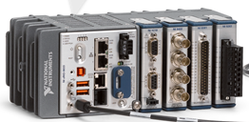
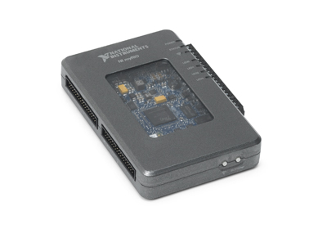
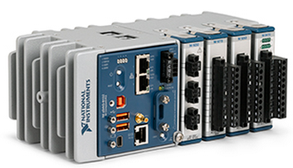
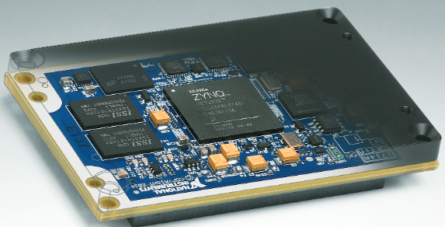
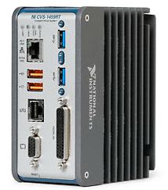
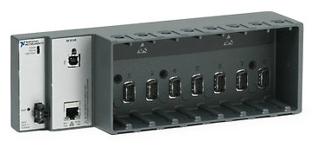
Hardware Supported by NI Linux Real-Time
Notes:
Note: This is NOT an exhaustive list
RoboRIO
CompactDAQ
VirtualBench
Etc.

Slide 5

“Within 24 hours of receiving a cRIO-9068 controller, we ran our existing LabVIEW application software without any problems.”
– Bob Leigh, CEO of LocalGrid™
Power Monitoring
LocalGrid
Notes:
Main Message:
It’s possible to move to NI Linux Real-Time easily; it offers the same, familiar LabVIEW experience. This portability was validated by LocalGrid as it took them under 24 hours to port a complex power monitoring application to a NI Linux Real-Time target.
The Linux OS side only affects users who want to use it and dive deeper.

Slide 6


NI Linux Real-Time
Enjoy the flexibility of Linux, with the determinism and reliability of a real-time operating system.
Desktop UI, Peripherals, System Administration, Real-Time schedulers
Leverage the vast ecosystem of tools and IP
Networking, Configuration Management, Simulation, Monitoring, etc.
Reuse C/C++ code in and alongside LabVIEW Real-Time built applications
FPGA Interface C API, System Configuration C API

Slide 7


NI Linux Real-Time
Owned and maintained by NI
Custom built and optimized for NI embedded hardware
Supports ARM and x64, with cross-compilers provided
NI Package Repository: download.ni.com/ni-linux-rt/
Over 3,000 packages
OS source: github.com/ni
PREEMPT_RT
Enables real-time reliability through pre-emption, priority inheritance, and scheduling
Standard approach to real-time performance on Linux
Notes:
The NI Linux Real-Time OS is characterized by a few key things:
Yearly updates (owned/maintained) – done against LTSI
We contribute back to the community
PREEMPT_RT: This is the open source effort that NI joined and built upon. PREEMPT_RT is the recognized way of achieving real-time performance with Linux. We have been able to contribute significantly to this community with our work. Enables real-time reliability with pre-emption and priority inheritance → PREEMPT_RT does more than Linux normally does (there’s some of this in Linux vanilla)
2. Dual Mode OS: This is a fundamental characteristic of Linux that separates it significantly from our existing Real-Time Oses (VxWorks and Phar Lap/ETS). In a dual mode OS, there is a separation between the kernel memory space and user memory space. Additionally, each user has a separate memory space, and applications don’t have the ability to arbitrarily affect the kernel or other applications. This results in a more robust and secure system – one that is much more resilient to crashes. Notably, if any application does crash, the NI Linux Real-Time operating system will continue to run, and can either restart the crashed application or take other action to remedy the crashed application.
3. Scheduler: It’s important to note that NI Linux Real-Time offers more efficient scheduling. Unlike previous RTOSes from NI which had only one real-time scheduler onboard, NI Linux Real-Time has a real-time scheduler for all time critical tasks, and a more efficient completely fair scheduler for all non-real-time tasks.

Slide 8

NI Joins Linux Foundation as Silver Member
The Linux Foundation is a non-profit consortium dedicated to fostering the growth of Linux and is supported by leading Linux and open source companies and developers from around the world.
NI is a key collaborative partner in the PREEMPT_RT Real-Time patch set
NI Linux Real-Time OS kernel source posted at https://github.com/ni
Notes:
We contribute to this patch both with $$$ and by submitting patches and bug fixes to be approved by the maintainers
-http://www.linuxfoundation.org/

Slide 9

NI Linux Real-Time Enables New Functionality
Convenience of a General Purpose OS
New: Embedded UI, File Manager, Terminal Emulator, Text Editor
Permissions, Application Isolation, Virtual Memory, no reboot required for Time Zone and IP Configuration changes
Access to popular interpreters
Python, Perl, etc.
Common Linux utilities
top, ps, netstat, etc.
Notes:
NI Linux Real-Time also brings to table some nice quality of life improvements
Desktop UI: comes with a virtual keyboard
app isolation: through permissions & memory sandboxing
The biggest one worth calling out is Memory Use – if presenting this slide, you can query the audience on how many people have historically tracked Contiguous Memory Use on current cRIO systems. You can let all those who raise their hands know that they no longer need to worry about tracking Contiguous Memory – unlike VxWorks and Phar Lap that use a physical memory representation, NI Linux Real-Time has the approachability of a General Purpose Operating system as it uses Virtual (Paged) Memory. This means that users just need to track overall memory, and don’t need to worry anymore about Contiguous Memory.
One key caveat that is worth pointing out again is that while Virtual Memory is great – that Linux RT is much less forgiving about poor programming practices. Doing memory allocations within time critical loops results in much more jitter on an NI Linux Real-Time system than it did on VxWorks on Phar Lap. The takeaway? Linux is much more approachable, but it’s much more important to follow best practices for real-time programming now more than ever!

Slide 10
File System & Connectivity & Basic Commands
Notes:
Now that we have overviewed the hardware and some basics architectural elements concerning the NI Linux Real-Time OS, we will now shift focus to the Filesystem

Slide 11
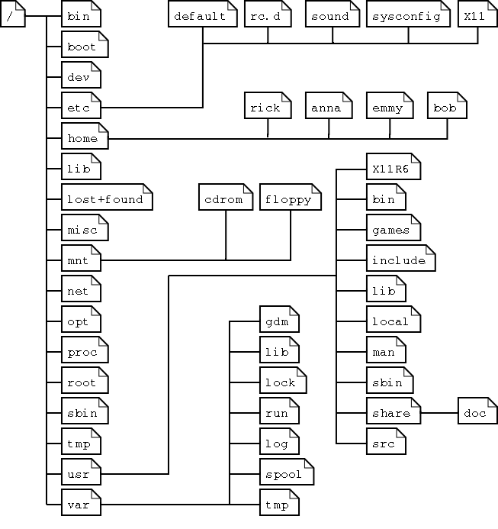
File Systems on NI Linux Real-Time
Reliable File Systems
UBIFS on ARM
ext4 on x64
File Path changes
Unix style, case sensitive
Locations of system files have changed
Symbolic links for basic backwards compatibility
Example: /u/ is the USB mount point
Notes:
Note that there are fundamental differences in the Filesystem on NI Linux Real-Time. The good news again is that users don’t need to concern themselves with these nuances if they don’t want to – it’s relevant only for those who want to dive into Linux RT deeper.
UBIFS is the most reliable and performant for flash
ext4 is the standard for SATA SSDs
ni-rt.ini file location has moved – discourage people from using it because we want to move away from it but still there and located in /etc/natinst/share
So now that we can see the differences in the general file system and paths, let’s move on to talking about accessing these files

Slide 12
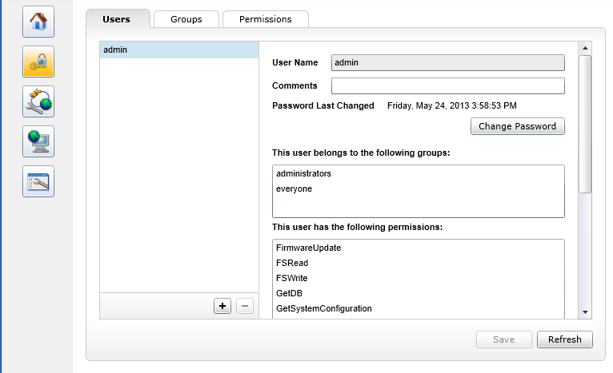
NI-Auth and NI Linux Real-Time Integration
All user authentication goes through NI-Auth
Use the Web Interface to manage users
http://<Target_IP_Address>
http://<Target_Hostname>
PAM Integration
Users in NI-Auth are users in Linux
admin user is superuser
If admin password is lost, target must be reset to factory default
Notes:
Overall, users who are granted certain permissions can access the file system.
An exciting new feature of NI Linux Real-Time is that ALL user authentication goes through NI-Auth – and securely so! This is different from current cRIO targets, in which NI-Auth protected only a few parts of the system (for example, the open FTP server) – and it was easy to bypass and/or compromise. This is no longer the case! On NI Linux Real-Time systems, NI-Auth piggybacks on Linux users and permissions to create a robust and thorough authentication mechanism which offers much better security to users.
To get superuser/root access over SSH, use the admin account – all accounts and permissions can be managed using the Web Interface.
KB 6H58QAR0: How Do I Manage User Accounts on NI Linux Real-Tme OS Devices

Slide 13
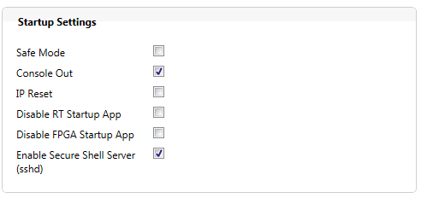
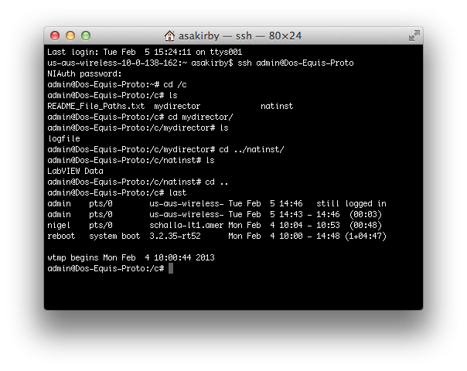
Secure Shell (SSH)
Enable through MAX and/or Web Interface
Can be used as a console
Can be used to transfer files
Permissions based on login
SFTP
Credentials synchronized with NI-Auth (Web Interface)
KB 6H2CJRR0 How Do I Access the Shell on a NI Linux Real-Time OS Device?
Notes:
Let’s dive into specifically accessing the files now. There are a few options around and one of them is SSH.
An exciting feature of NI Linux Real-Time is SSH. Secure Shell needs to be enabled first (which can be done through MAX or through the Web Interface). SSH can be used as a console, and also provides access to the command line. Furthermore, it’s possible to securely transfer files over SSH (using SFTP).
Note that the credentials for SSH are synchronized with MAX – these credentials can be setup and managed through the Web Interface.
Can’t use useradd or adduser but can use passwd command as long as not a blank password

Slide 14
File Transfer: Unsecure FTP
No unsecure FTP server installed by default on NI Linux Real-Time systems
Unsecure FTP server can be manually installed for compatibility
Must be accessed as the ‘anonymous’ user
Has root privileges similar to current cRIO
Use WebDAV or WinSCP instead
Not Recommended
Notes:
For those who have legacy applications that absolutely must rely on an open FTP server, it’s possible to install an insecure FTP server onto NI Linux Real-Time targets. This is not recommended as it compromises the network security of the device.
USE WEBDAV or WinSCP instead

Slide 15
Exercise 1: Connectivity on NI Linux Real-Time
Goal: Familiarize yourself with different ways to connect to your NI Linux Real-Time target, Linux Real-Time permissions
Objectives:
Use MAX to configure NI Linux Real-Time device
Use Web Based Configuration and Monitoring Interface to configure NI Linux Real-Time settings, user accounts, and permissions
Use WebDAV or WinSCP to navigate file system
Use terminal client to SSH into device to navigate file system
Notes:
Note: You must have an NI Linux-Real Time device – either a cRIO-9068 or a myRIO will do.
Say to Audience:
Let’s take a moment to see NI-Auth, WebDAV, and SSH and show off how permissions work on the new NI Linux Real-Time OS!

Slide 16
Common Linux Commands
Basic BASH available
Command | Description | Example
top | Ongoing look at processor activity in real time | top
netstat | List information about current network connections, etc. | netstat
ls | List directory contents | ls
echo | Commonly used to output status text to screen or file | echo “test” > test.txt
vi | Built in visual editor | vi test.txt
rm | Remove files or directories | rm test.txt
mv | Move or rename files | mv test.txt new.txt mv test.txt /home/admin
Notes:
Here’s a little cheat sheet to help you through the exercise.
Like we covered earlier, NI Linux Real-Time has the benefit of incorporating general and common Linux utilties. One of the included items is BASH. BASH is a command processor but can also read commands from a file called a script. More will be covered on creating scripts in the next session
Find more commands online

Slide 17
Exercise 1: Connectivity on NI Linux Real-Time
Key Takeaways:
FTP Server is not installed by default
Can use Hostname or IP Address to connect to cRIO
Can create, copy, move, delete files via WebDAV, WinSCP, or SSH
Can’t use SSH to add users but can change to a non-blank password
Notes:
Note: You must have an NI Linux-Real Time device – either a cRIO-9068 or a myRIO will do.

Slide 18
Flexible Development & Vast Community
Notes:
Now that we have overviewed some on navigating and using the filesystem concerning the NI Linux Real-Time OS, we will now shift focus to the development environment and options you have for developing.

Slide 19

Access the Ecosystem: Linux Package Manager
What is a package manager?
Set of software tools for installing, updating, configuring and removing utilities and libraries
Similar in concept to the App Store, VI Package Manager, etc.
NI Linux Real-Time relies on the opkg package manager
Note: opkg does not take the place of MAX
Access to thousands of freely available utilities and libraries
Notes:
Outside of LabVIEW and NI, there is a vast community of utilities and libraries that you can use with the NI Linux Real-Time OS. Similar to the support, but the delivery of these user mode applications are different.

Slide 20
Exercise 2: opkg and databases
Goal: Leverage Linux Community and familiarize yourself with accessing, installing, and uninstalling non-NI utilities/libraries via opkg and how it interacts with LabVIEW
Objectives:
Install SQLite [Samba Server later?] from opkg
Create a shared mounted folder
Use LabVIEW to interact with SQLite and [Samba Server later?]
Write a measurement file to the server later?
Update
Notes:
Note: You must have an NI Linux-Real Time device – either a cRIO-9068 or a myRIO will do.
Say to Audience:
Now that we talked about the huge options available, let’s take a moment to see work with opkg and working with a mySQL database. Just so you can see the power this community gives us as developers.

Slide 21
Exercise 2: opkg and databases
Key Takeaways:
opkg included options for database software and application to mount shares – many more options available
Using System Execution VI or Call Library Function Node to interact with software installed on NI Linux Real-Time target later?
opkg feed is enabled by default
Can create more packages etc by building from scratch as our source is online github.com/ni/nilrt
Update
Notes:
Note: You must have an NI Linux-Real Time device – either a cRIO-9068 or a myRIO will do.
Key takeaways
Resources?

Slide 22
Leveraging the Linux Community
NI Package Repository: download.ni.com/ni-linux-rt/
OS source: github.com/ni
Kernel Driver Support
Advanced feature; avoids rebuilding kernel modules/drivers against all kernel updates
Databases
SQLite
MySQL
Security
IPTables
OpenSSL
Code Reuse
C/C++
Shell Scripts
Connectivity
NTP
SNMP
IPv6
Python
OpenVPN
PostgreSQL
Notes:
The buckets at the bottom are some of the avenues in which users can benefit from the Linux community when working with products that run the new NI Linux Real-Time OS.

Slide 23



Security on NI Linux Real-Time
SSL enabled by default
Can programmatically install software over SSL
Can use public keys for SSH
HTTPS-only communication possible
Can turn off HTTP version of the System Web Server
IPTables* available for setting up a firewall
OpenVPN* available for setting up a VPN
SELinux*
*Not supported by Applications Engineering. Requires experience. No LabVIEW API
Notes:
Now that we had a chance to see some of the new features, we can address another aspect of the development environment: security on NI Linux RT. NI has taken the time and effort to bring to market a more robust and secure system:
We now have SSL enabled by default (you can get this by opening Internet Explorer and navigating to “https://<hostname or ip address of target>”
It’s possible to turn off HTTP only traffic on the System Web Server. This is a setting that is configured through the Web Interface
We have IPTables and OpenVPN on the target. By default, these packages are dormant – it’s up to a user with requisite skill to use these features. Alternatively, NI’s Systems Engineers and Applications Engineering Specialists can help implement these security features.
SE Linux: We’ve experimented with it. Would be an NRE/Custom Engineering task if someone was truly interested; would also need to engage a partner for policy creation
BEFORE NEXT SECTION: Purpose is to introduce the concept of security packages. This is not recommended as a one time set up. Both of these options, since it is a direct change in security, are expected that the end-user needs to maintain these configurations over time.

Slide 24

“By leveraging the open Linux-based real-time operating system on a commercial off-the-shelf controller, we could port our existing Linux software components in a very short time. That saved us at least four months of development time.”
- Wolfram Koerver, executive director of S.E.A.
Structural Monitoring
S.E.A
Notes:
Main Message:
SEA is a good example of the power of the Linux Ecosystem. They brought to market very quickly a condition monitoring platform that they were able to heavily augment with Linux. Specifically, they:
Implemented a System Security at a Low Cost
- Firewall and VPN
Achieved Flexible Networking and Communication
- Improved Linux network stack
- Easy access to comm protocol
Were able to Acquire Time-Correlated Measurements With GPS Easily
- Leverage Linux GPS driver
- Reuse Linux time protocol driver - NTP
==============
Details:
We have a case study available: http://sine.ni.com/cs/app/doc/p/id/cs-15689
==============
More Resources:

Slide 25
Support Policy
Limited user mode support
Equivalent to 3rd party C code with Call Library Nodes on Desktop
No support for kernel mode changes
NI Linux Real-Time source available at github.com/ni
Feel free to innovate and explore
Can restore to factory default state without having to RMA

Slide 26
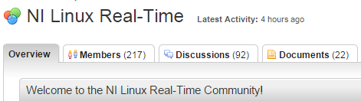
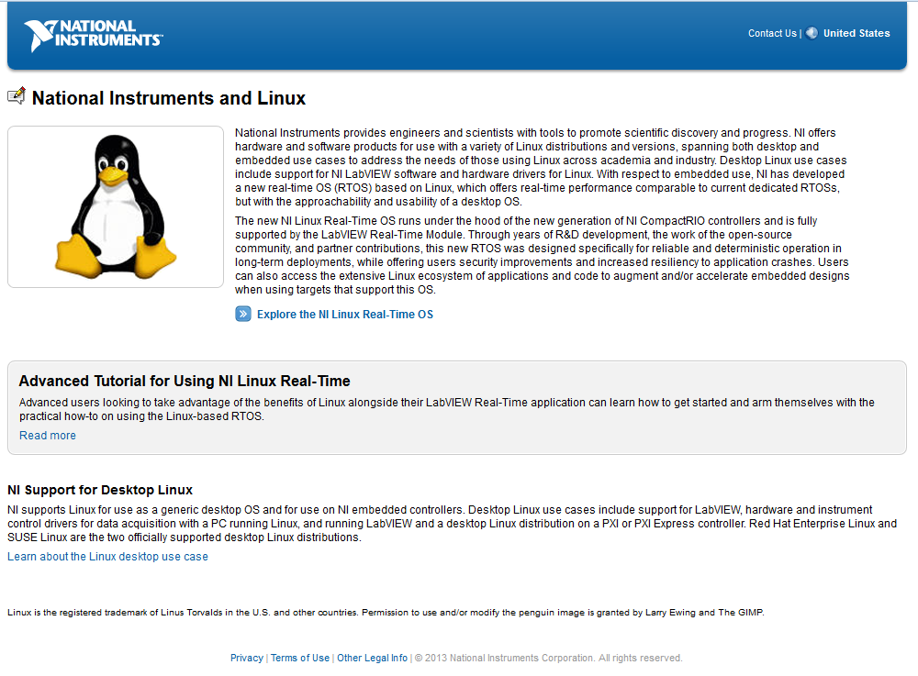
Key Resources
ni.com/linuxrtforum
Tutorials
Documentation
Forum for discussions
ni.com/linux
Links to whitepapers
Embedded and Desktop uses
download.ni.com/ni-linux-rt/
Package Repository
github.com/ni
OS Source
Update
After 3/12
Notes:
Key Resources – these are the call to action

Slide 27
Questions?

Slide 28
C Code Development on NI Linux RT
Brian Kindinger
Embedded System Engineer

Slide 29
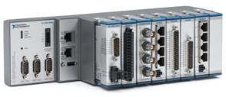
Why C Code on cRIO?
Existing C Code they want to port
Customer expertise or interest
Restrictions on development tools

Slide 30
Why NOT C Code on cRIO?
It is faster than LabVIEW
Lower level control
It is smaller than a LabVIEW application

Slide 31
Outline
Setting up Eclipse
“Hello World”
Basic Debugging
Blink the LED
C FPGA Interface
Multi-threading using pthread

Slide 32

Setting up Eclipse
Integrated Development
Environment
Created using Java – requires
Java Runtime Engine
General purpose IDE including Ada, ABAP, C, C++, COBOL, Fortran, Haskell, JavaScript, Lasso, Natural, Perl, PHP, Prolog, Python, R, Ruby, Scala, Clojure, Groovy, Scheme, and Erlang*
Plug-in cross-compilers

Slide 33
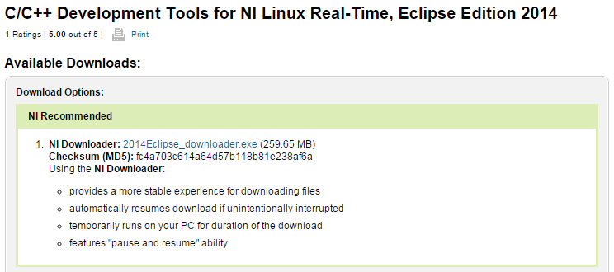
Setting up Eclipse
Do we want to have this
already installed
To save time?
Install Java Runtime Engine (JRE)*
Install “C/C++ Development Tools for NI Linux Real-Time, Eclipse Edition 2014” from ni.com
Eclipse IDE
Cross-compilers
Project templates
Run Eclipse and setup workspace

Slide 34
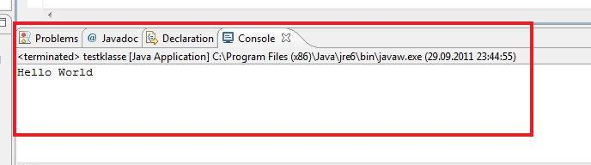
“Hello World”
Instructions http://www.ni.com/tutorial/14625/en/
Created new Hello World ANSI C project
Configure a cross compiler
Create a build spec (also add rt, and dl to linker)
Compile
Enable SSH on target through MAX
Add remote target to Eclipse
Execute the Code

Slide 35
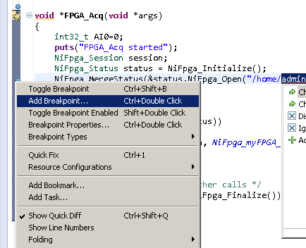

Basic Debugging
GDB debugger - GNU Project Debugger
Starts your program
Make your program stop on specified conditions
Examine what has happened, when your program has stopped

Slide 36

Blink the LED
Resources in Linux typically showup as files
FILE *LED = NULL;
LED=fopen("/sys/class/leds/nizynqcpld:status:red/brightness","w");
fwrite("0\n",sizeof(char),2,LED);
fwrite("255\n",sizeof(char),4,LED);
fflush(LED);
fclose(LED);

Slide 37
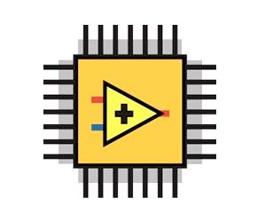
C FPGA Interface
Bitfile
C
interface
Create a simple LVFPGA example
Build the FPGA bitfile
Install FPGA Interface C API
Transfer bitfile to Linux Target
There is a more complex example online*

Slide 38
C FPGA Interface
#include "FPGA\NiFpga_myFPGA.h“
NiFpga_Session session;
NiFpga_Status status = NiFpga_Initialize();
NiFpga_MergeStatus(&status,NiFpga_Open("/home/admin/helloworld/FPGA/NiFpga_myFPGA.lvbitx",NiFpga_myFPGA_Signature,"RIO0",0,&session));
NiFpga_ReadI32(session, NiFpga_myFPGA_IndicatorI32_AI0, &AI0);
NiFpga_ReadI32(session, NiFpga_myFPGA_IndicatorI32_AI0, &AI0);

Slide 39
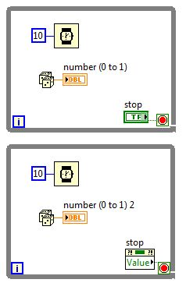
Multi-threading using pthread
pthread_create(&t_StatusLED, NULL, blinkStatus, (void *)100);
pthread_create(&t_FPGA_Acq, NULL, FPGA_Acq, (void *)100);

Slide 40
Multi-threading using pthread
#include <pthread.h>
Add pthread to GCC Cross Linker in project
Create functions void *blinkStatus(void *args) & void *FPGA_Acq(void *args)
In main()
pthread_t t_StatusLED;
pthread_t t_FPGA_Acq;
pthread_create(&t_StatusLED, NULL, blinkStatus, (void *)100);
pthread_create(&t_FPGA_Acq, NULL, FPGA_Acq, (void *)100);
while(1)
{
sleep(1);
}

Slide 41

Native Compile
Advanced users may not want to use a cross-compiler
They will native compile by:
Install compilation tools to the cRIO
Coding
Transporting the code to the cROP (SFTP)
Compiling the code on the cRIO using SSH interface
Not recommended for beginners
If a customer wants to do this, use the forums. https://decibel.ni.com/content/groups/ni-linux-real-time

Slide 42
Leftovers
Microsecond clock is accessed through clock_nanosleep();
Setting thread priority is done through sched_setparam();

Slide 43

Questions

